Slide 1
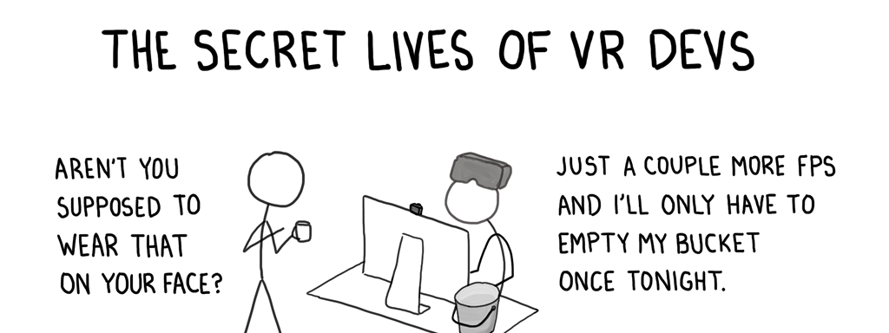
VR-tigo
Nick, Jaime, Cameron, Brandon, Rachel and Lavanya
https://twitter.com/vmccurley/status/634450960543285248

Slide 2
description
VR Minigame
Portal puzzle game
Navigate a level by using portals to get around
Score awarded based on time, number of portals placed, extra items retrieved
Scoreboard compares players against each other.
Bartle’s Player Types:
Achievers
Killers

Slide 3
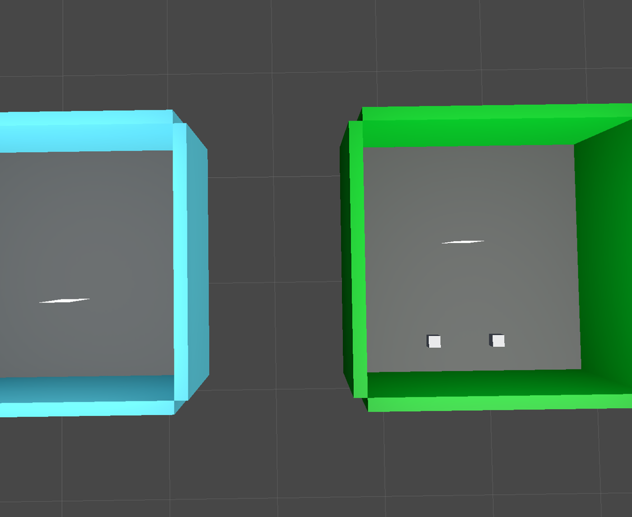
PROGRESS
This is our main development environment
WHY?
Portal Creation
Portal Mechanics
Portal Teleportation
VR Movement

Slide 4
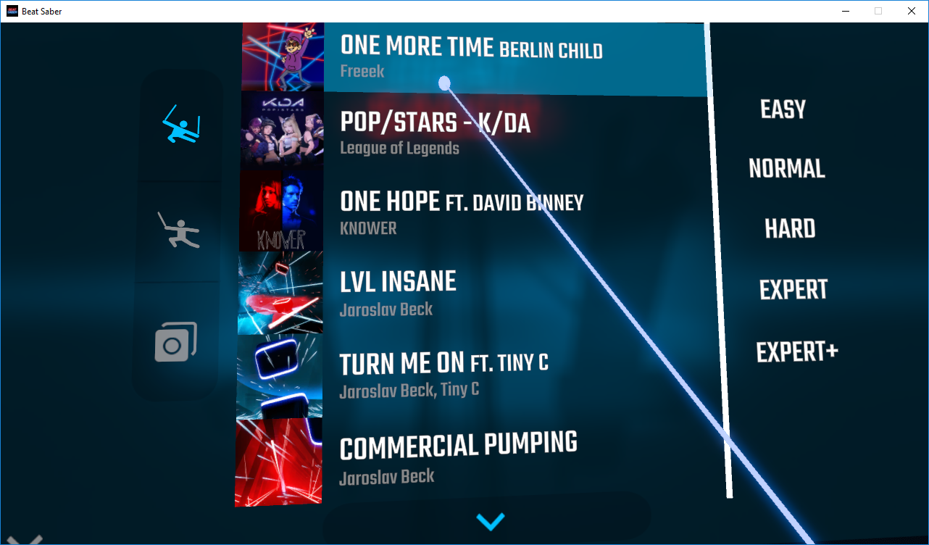
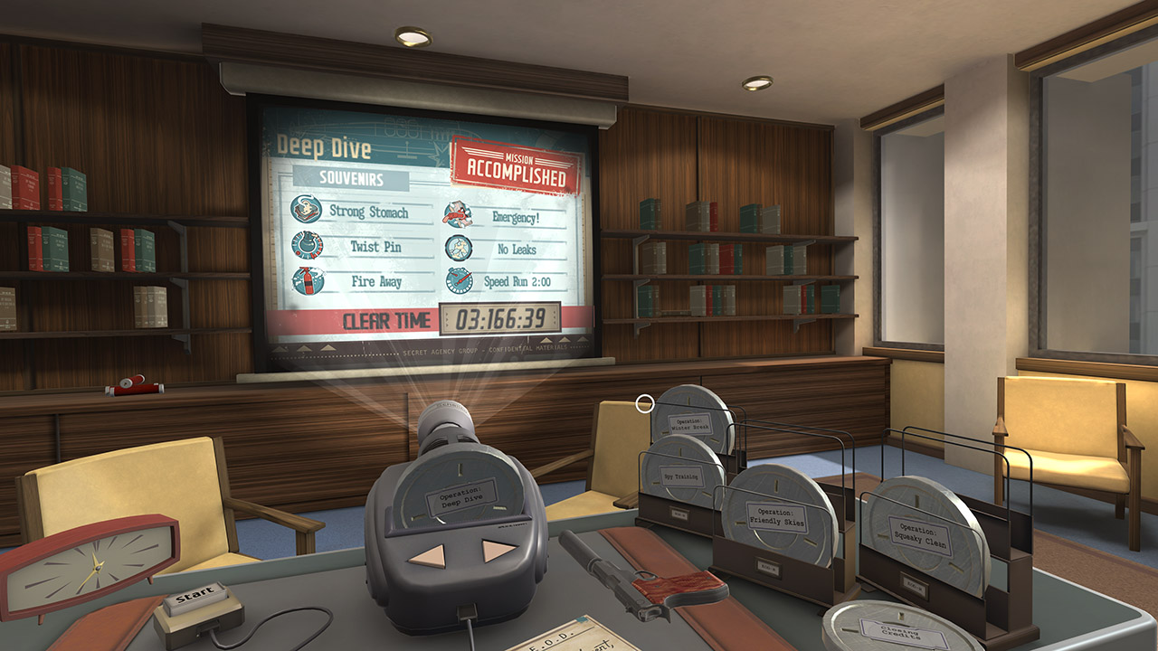
EXPERIMENT DESIGN
Doing this internally so far, but in the future will be testing externally soon.
Navigating the level in VR
Movement
Portals
A/B testing
“laser pointer” interface (present in the world space, but not integrated into the scenery, as in “Beat Saber”)
Immersive user interface (part of the scenery, as in “I Expect You To Die”)

Slide 5

Feedback?
Please direct your feedback to gitlab-incoming+swen422-2019-a2-t19-swen422-assignment2-5989-issue-@ecs.vuw.ac.nz

